Slide 1
CHINA’S DCEP PROJECT
-- DCEP: Short for Digital Currency Electronic Payment.
Zihao(Anderson) You
K1923149
29/10/2020

Slide 2
A BIT OF BACKGROUND
The Development of DCEP was started in 2014 but at this stage the development process was slow until 2018, due to the incompatibility between Bitcoin and Renminbi.
As Facebook has prepared to launched its Libra digital currency since June 2019. China felt the heat of the competition, then speeded up in the global competition towards a digital currency.
The main differences between DCEP and the existing mobile payment (WeChat/Alipay): People can transfer money simply by tapping two phones together, without the use of the Internet. Also DCEP doesn’t require the mobile device to be bound to a bank account.

Slide 3
A comparison of the different features between DCEP, Libra, Bitcoin and Cash.
 | DCEP | LIBRA | BITCOIN | CASH
Anonymous? | Can be made anonymous | Yes | Yes | Yes
Type of technology used? | Smart contract, asymmetric cryptography etc. | Consortium blockchain | Public blockchain | Nil
Efficiency? | High | High | Low | Low
Decentralised? | No | Partially | Yes | No
Volatility? | Low | Low | High | Low
Portability? | High | High | Medium | Low
Security? | High | High | High | Low
Offline payment support? | Yes | No | No | Yes
Transaction speed (TPS/sec)? | 220,000 | 1,000 | 7 | N/A
Current Status | Undergoing testing | In development | In circulation | In circulation

Slide 4
MARKET SIZE
As DCEP is still in the testing phase, I will instead talk about the market size for two platforms which are used for mobile payment.
More than 600 million Chinese already use Alibaba’s Alipay and Tencent’s WeChat Pay to pay for much of what they purchase. Between them, the two companies control approximately 90% of China’s mobile payments market, which in total $17 trillion in 2019.
In the first quarter of 2020, Alipay had 55.4% of China’s mobile payment market, according to Beijing-based iResearch, which estimates mobile payments will reach RMB140tn ($19.9tn) this year.
Annual growth: approximate 17%.

Slide 5
FEASIBILITY
Last month, this project has undergone the closed pilot tests in Shenzhen, Chengdu, Suzhou, Xiong’an and some locations where the 2022 Winter Olympics will be held.
Eventually, the tests will be expanded to 28 cities and provinces including Beijing, Shanghai, Guangzhou and the Hong Kong Macau Greater Bay Area. The expansion means that the coverage of the pilot testing can include a potential user base of around 400 million people- 29% of China’s population.
Places where DCEP has been tested include: some local hotels, unmanned supermarkets, postal lockers, bakeries, bookstores, gyms and foreign firms such as Starbucks, McDonald’s and Subway.

Slide 6
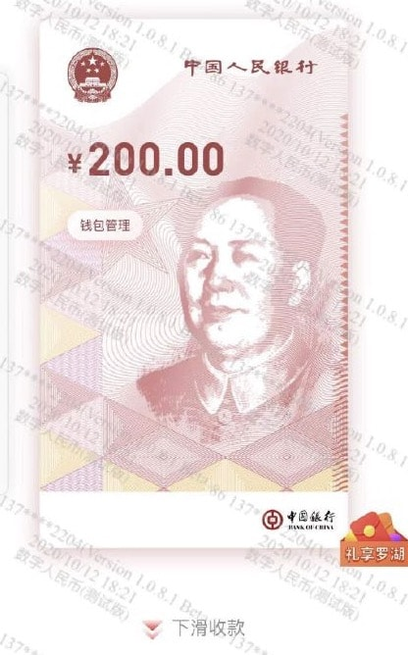
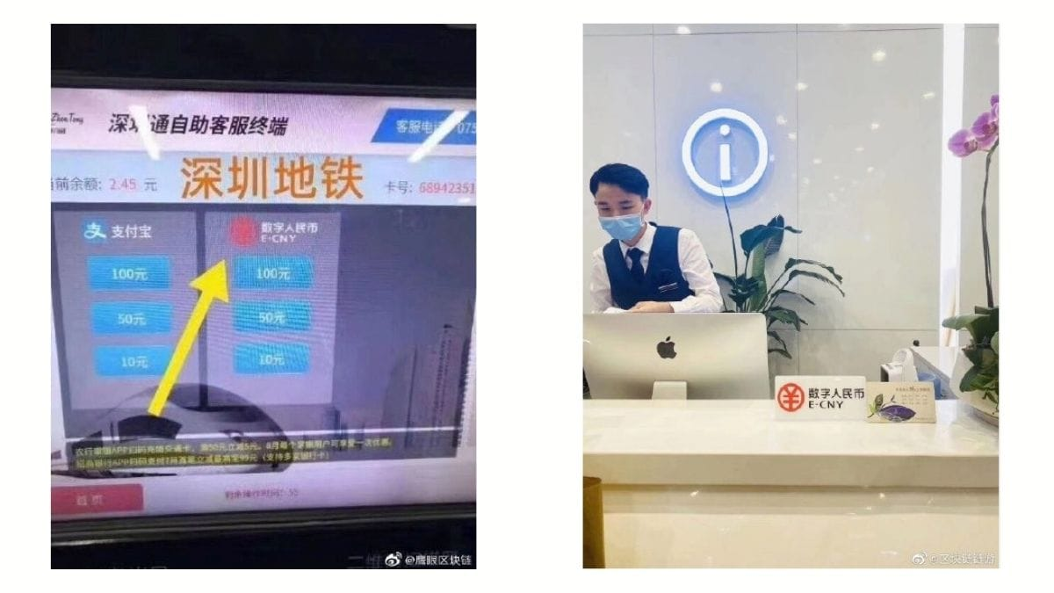

Slide 7
PROBLEM
Beijing has wanted to boost the yuan’s stature in the global financial system—or “internationalize” the yuan, as the lingo goes. However, almost 40% of global transactions on SWIFT are denominated in dollars, compared to less than 2% in yuan—has frustrated Chinese officials. Theoretically, if enough countries adopted the digital yuan for international payment transactions over time, then it could one day challenge the dominance of the US dollar.

Slide 8
SOLUTION
A mature digital yuan would allow China to bypass Western sanctions, enabling users to trade a major currency internationally without using the SWIFT system. SWIFT’s member banks serve as a critical chokepoint for law enforcement and international policy. They are required to police all transactions on their networks for money laundering, sanctions violations, and other criminal activities. Because of the dollar’s dominant status in international trade, the U.S. government wields a powerful enforcement lever over institutions that fail to comply. This is an essential mechanism that, for instance, enables the United States to monitor transactions related to Iran’s nuclear program. It is also used to enforce sanctions against Chinese interests accused of violating intellectual property laws and human rights violations in Hong Kong, Xinjiang, and beyond.

Slide 9
REFERENCES
https://www.forbes.com/sites/rogerhuang/2020/07/24/why-cryptocurrency-matters-in-the-coming-fight-between-the-digital-yuan-and-dollar/#66bf85e433f4
https://finance.yahoo.com/news/same-problems-plaguing-yuan-plague-063918722.html?guccounter=1&guce_referrer=aHR0cHM6Ly93d3cuZ29vZ2xlLmNvbS8&guce_referrer_sig=AQAAAB5uJInAVUHKbjckaUEtWdVCQ8n25_YsyTywnwfC82Zs5_giDbnkW5RbHG3h2_b30T44E3lf5WN4-4nLVGPPVZKn2EKK_3dyva2bEqYnVrL7jpBySYd8Vg1cxb4My6BdljCixQ1g0Pga2kljExI_mYz8ayILiN60LsZVXVm8SWcC
https://www.fpri.org/article/2020/09/understanding-chinas-digital-yuan/
https://asiatimes.com/2020/08/digital-yuan-takes-aim-at-alibaba-and-tencent/
https://www.china-briefing.com/news/when-can-i-buy-use-and-trade-chinas-digital-yuan/
https://www.fairobserver.com/business/technology/daniel-wagner-china-digital-currency-electronic-payments-dcep-system-finance-tech-news-14221/
https://www.ubs.com/global/en/wealth-management/chief-investment-office/market-insights/regional-outlook/2020/dcep-chinas-digital-currency.html
https://boxmining.com/dcep/#Implications_of_DCEP_on_Bitcoin_and_cryptocurrencies
https://www.globalgovernmentforum.com/china-to-test-digital-currency-in-four-cities/
https://cointelegraph.com/news/chinas-digital-yuan-cbdc-is-close-but-many-details-remain-unknown

